Slide 1
TRACKING SARS-COVID-19 MUTATIONS ACROSS THE WORLD
Tanner Ashurst, Kaija Bryans, Maya Dixon, Christian Garnons-Williams, Kailee Morrison, Patrick O’Sullivan
Notes:
Hello everyone! We're group 2 and our presentation is entitled Tracking SARS-CoV-2 mutations across the world.

Slide 2
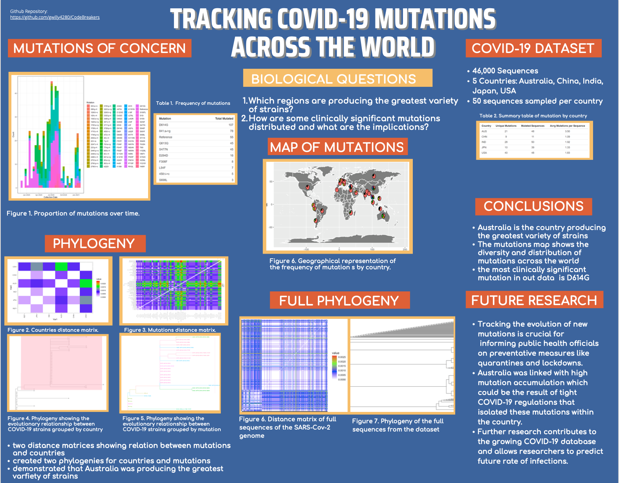
OUR POSTER
Notes:
Heres our poster! [comment on the poster’s colours idk] Now lets get into the sections.

Slide 3
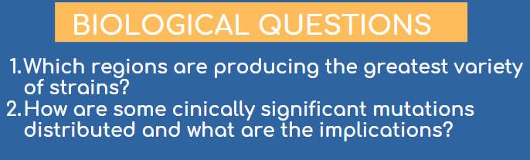
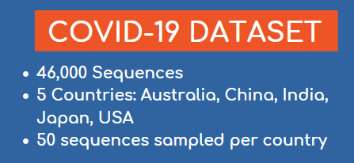
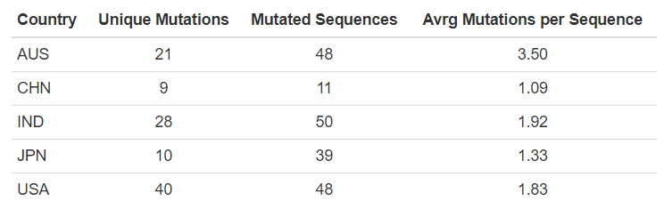
INTRODUCTION
Notes:
For our assignment we wanted to answer two biological questions:
How are mutations in the SARS-CoV-2 spike protein distributed geographically and temporally, and
How are some clinically significant mutations distributed and what implications do these distributions have for future vaccine effectiveness, and potential risk of antigenic drift?
To do this, we started with the full NCBI database of complete, ungapped SARS-CoV-2 genomes. The original dataset comprised 80,000 contigs, of which 46 thousand complete sequences formed our statistical population. This rich dataset contained GenBank accession numbers, date collected, date of first publication, name of first publication, country collected, and more.
To make our data more manageable we broke down our dataset into 5 subsets by country: Australia, USA, Japan, China, India, chosen based on the number of sequences available. We sampled 50 sequences each of our five countries, bringing the sample size to 250 sequences.
From there we used the accession numbers to pull the 250 complete sequences (each 28,000 BP in length) from NCBI; isolated the nucleotide sequence of the spike protein (3,800 BP in length) in each sequence; and performed a multiple alignment on these sequences, and using the output of this alignment to detect relevant mutations in the spike protein relative to the reference genome.
We compared these sequences to reference a dataset of known mutations in the spike protein to mutations of potential clinical interest. From this we found 99 unique mutations in the spike sequence, with 196 sequences out of the 250 having some kind of deviation from the original reference from December 2019.

Slide 4
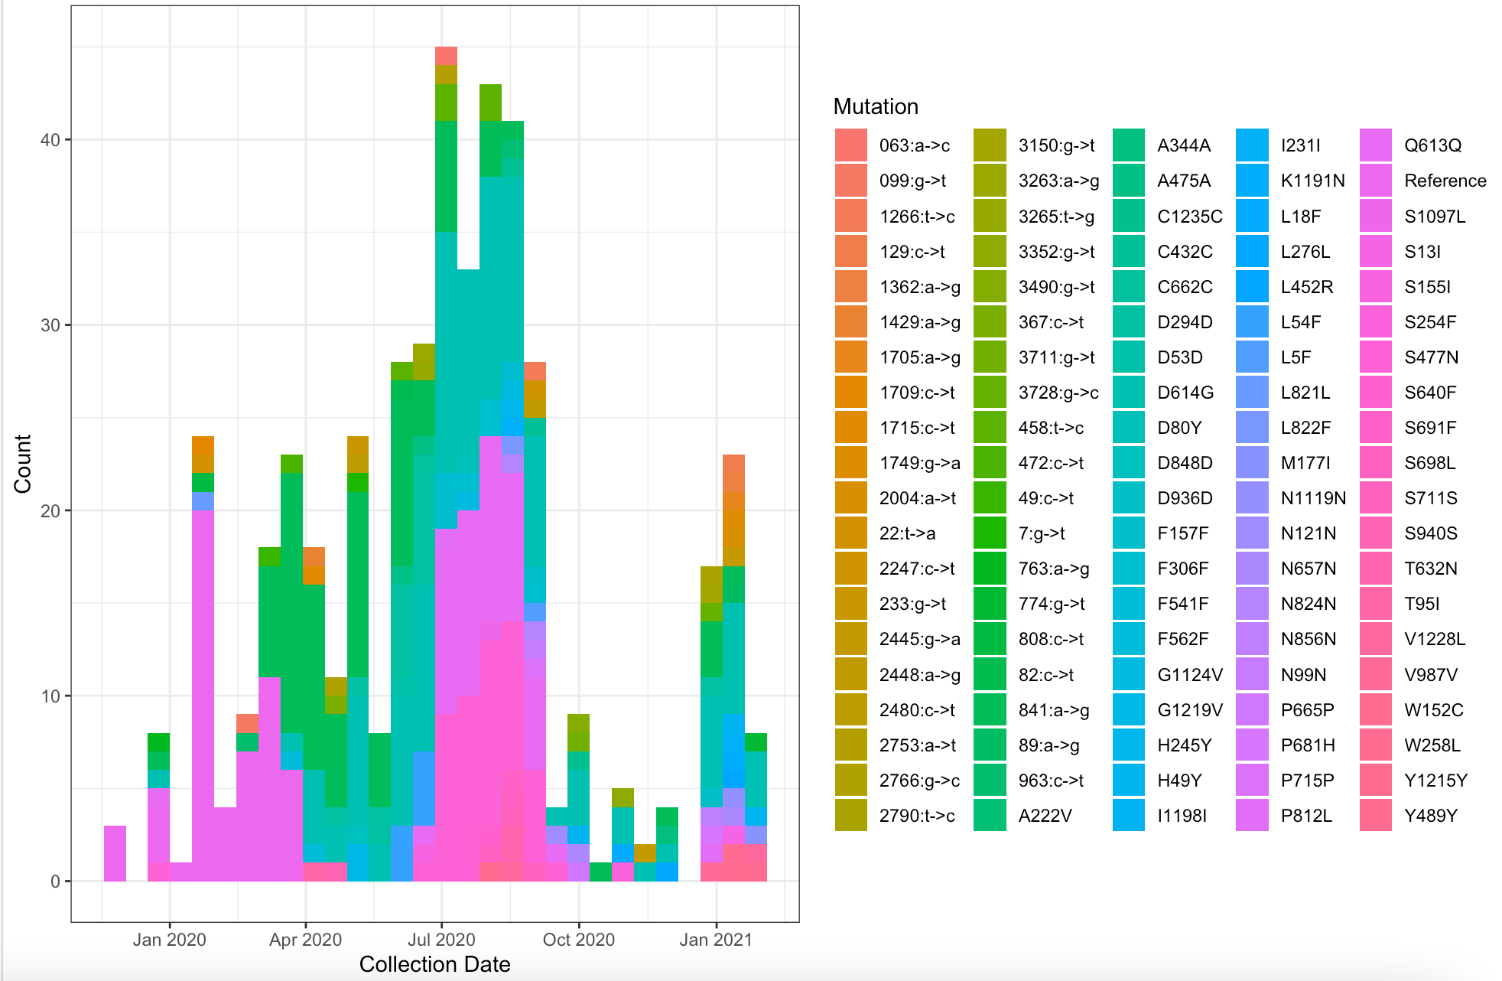
METHODS
Looking at variants of concern
Figure 1 presents proportional mutation reports (n=250), starting from 2020
More colours = greater diversity of mutations and strains reported for that time
A larger band = a higher proportion of reported cases
Demonstrates how mutations rise to, and fall from dominance in populations
Notes:
Part of our investigation lead us to examine some of the variants of concern. Here in figure 1, we can see the proportions of mutations reported since the start of 2020 (with a sample size of 250). These mutations occur in a spike protein sequence of the SARS-CoV-2 virus. In this figure, each mutation has its own colour, so the more colours in a given bar, the more diverse mutations were at that time. A larger band also indicates a higher number of cases containing a particular mutation. It is important to note the diversity of mutations recorded over time, as this information shows that any vaccine implemented, must be powerful enough to identify and protect against multiple possible strains, not just one or two. Data pertaining to the fall season is minimal in part due to the sample size used for this graph.

Slide 5
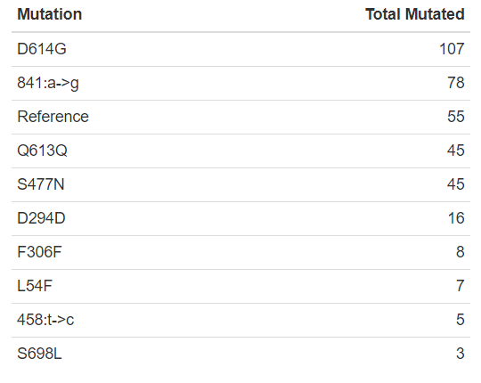
METHODS
Looking at variants of concern
Table 1 presents the total amount of each mutation from Figure 1
D614G is the most common mutation seen
There are several other prominent mutations
Notes:
The most common mutation noted in our research is the D614G mutation which causes a conversion of adenine (A) to guanine (G) at position 23,403 in the viral genome (1). This mutation is of clinical importance because of its relationship with the progression of the disease; causing an increase in the severity of COVID-19 observed in patients. More specifically, this mutation was found in 85.7% of severe cases compared to 45.7% of mild cases (1). This mutation is included within our data, and it should be noted that it has been detected in several different countries across multiple continents. This information, coupled with the knowledge of its impacts on disease severity, shows that this mutation is one of considerable concern, as it appears to increase infectivity as much as severity. This makes the D614G mutation a possible target for treatment plans, as much as a variation to intensely screen cases for.

Slide 6
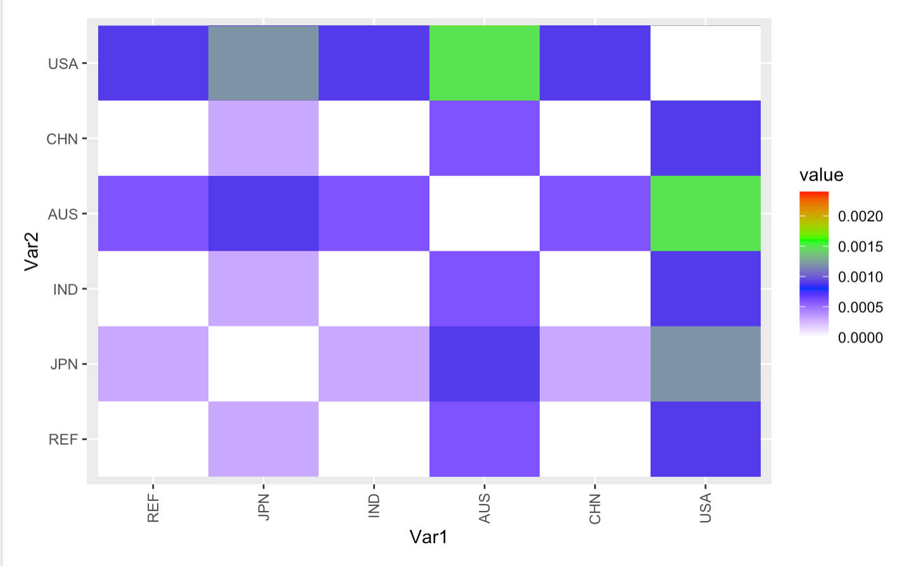
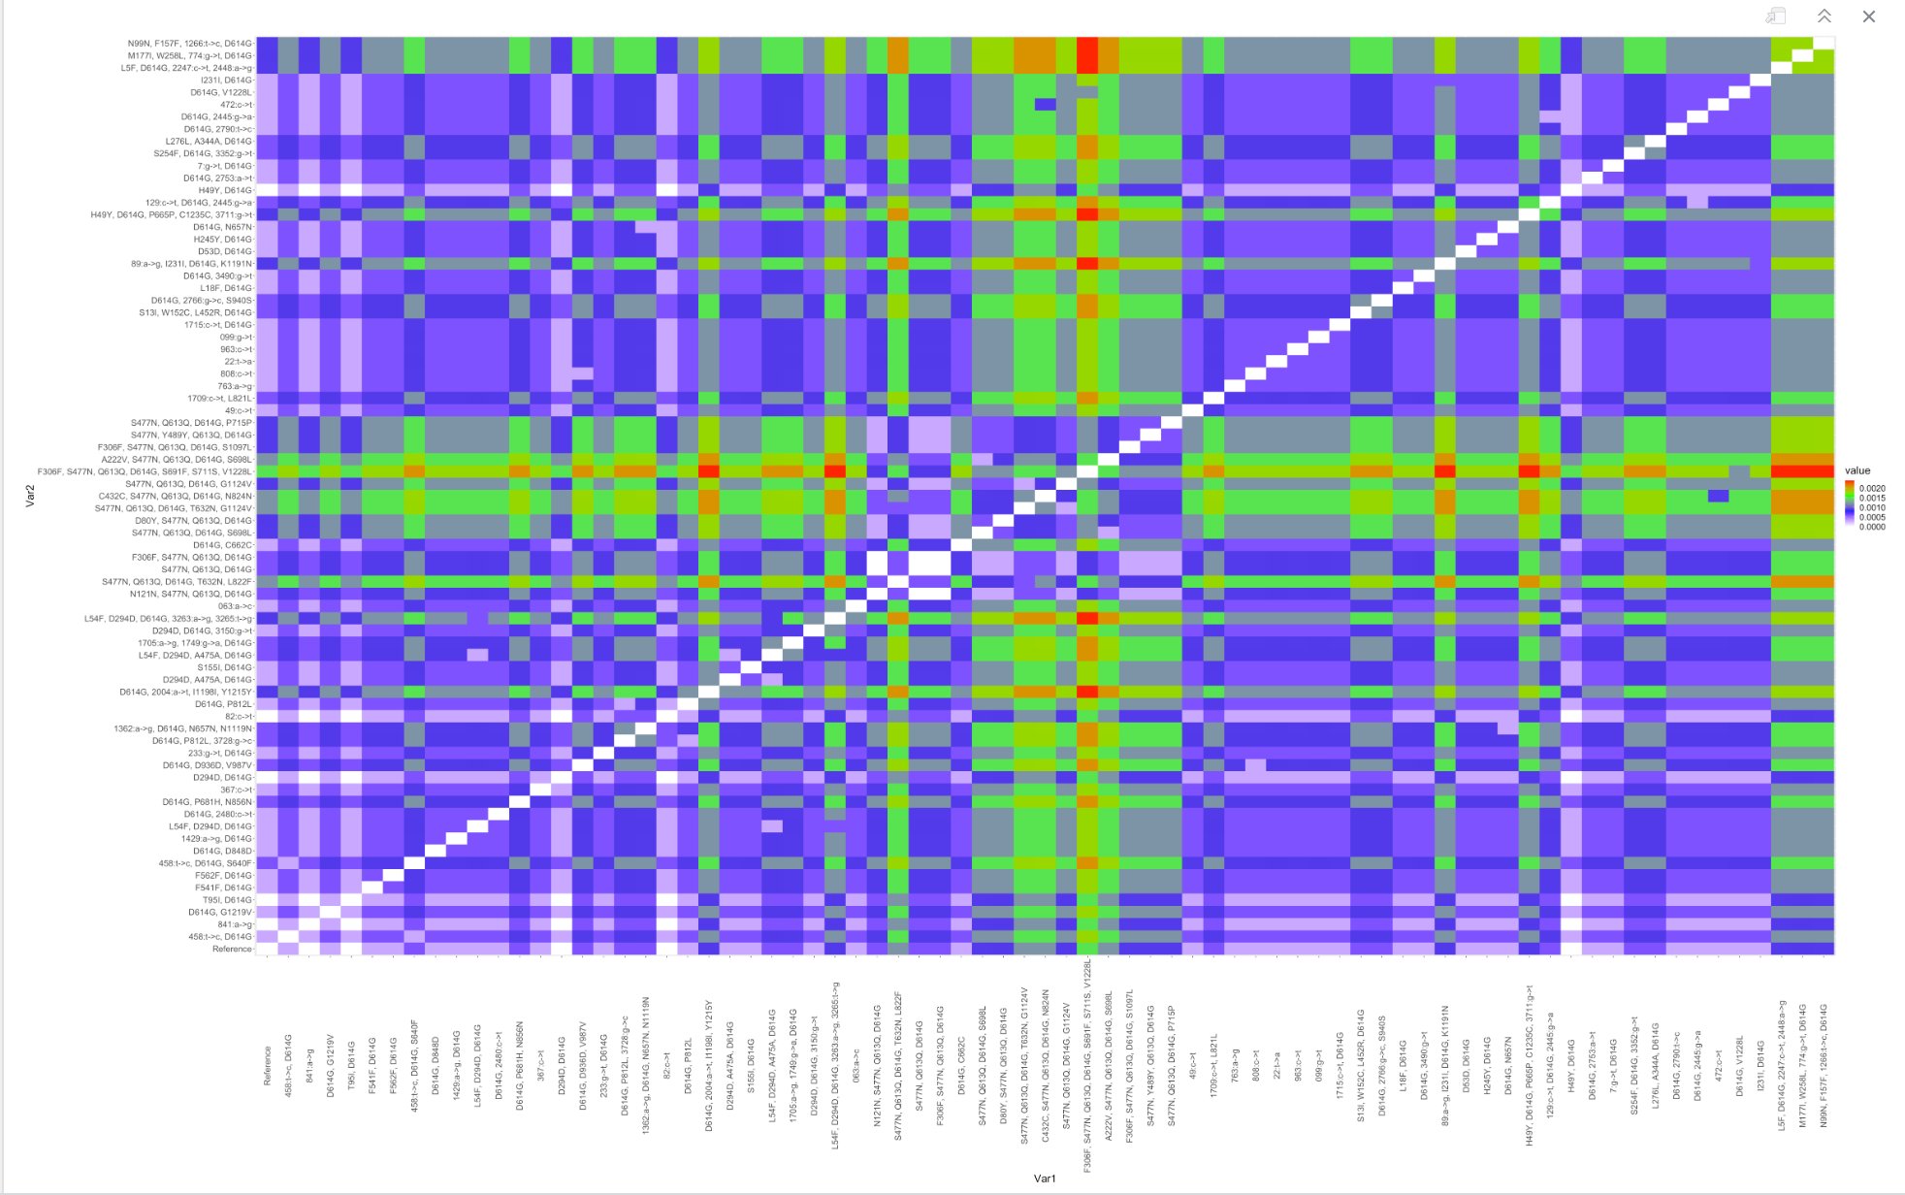
METHODS
Distance Matrices
Created an alignment of the subsetted data
Created two distance matrices
For countries
For mutations
Created two phylogenies
One for countries with highlighted clusters of interest
One for evolution of mutations
Demonstrated that Australia was producing the greatest variety of strains
Figure 3. Visual of distance matrix showing the similarity of sequences between different mutations.
Figure 2. Visual of distance matrix showing the similarity of sequences between countries.
Notes:
Our first biological question asks: which regions are producing the greatest variety of strains? This question was looked at through the creation of two phylogenetic trees, the first focusing on the country's COVID-19 evolution and the second at the mutations across the evolutionary tree. To create our phylogeny we began with the alignment of our subsetted data, then created distance matrices that demonstrated the similarity of the sequences between countries (Figure 2) and the similarities of the sequences between mutations (Figure 3). The distance matrix between the mutations is especially interesting, the green represents high dissimilarity and purple represents similarity between the sequences. The distance matrix shows us that the vast majority of the mutations are decently similar to one another, but also show that there are some seen in green and red that are greatly different. Those mutations are interesting in what they could mean for vaccine creation and spread of COVID.

Slide 7

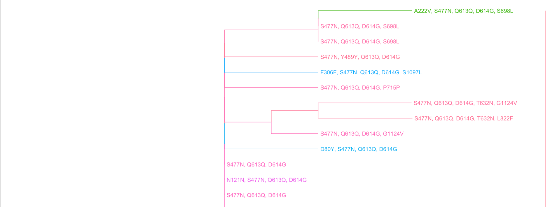
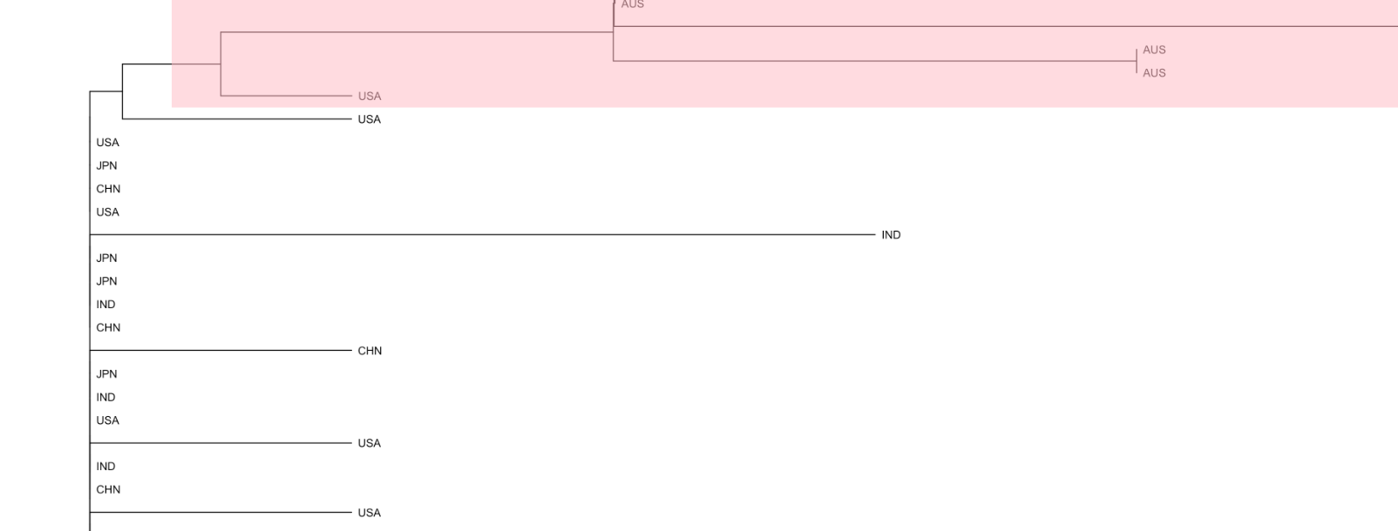
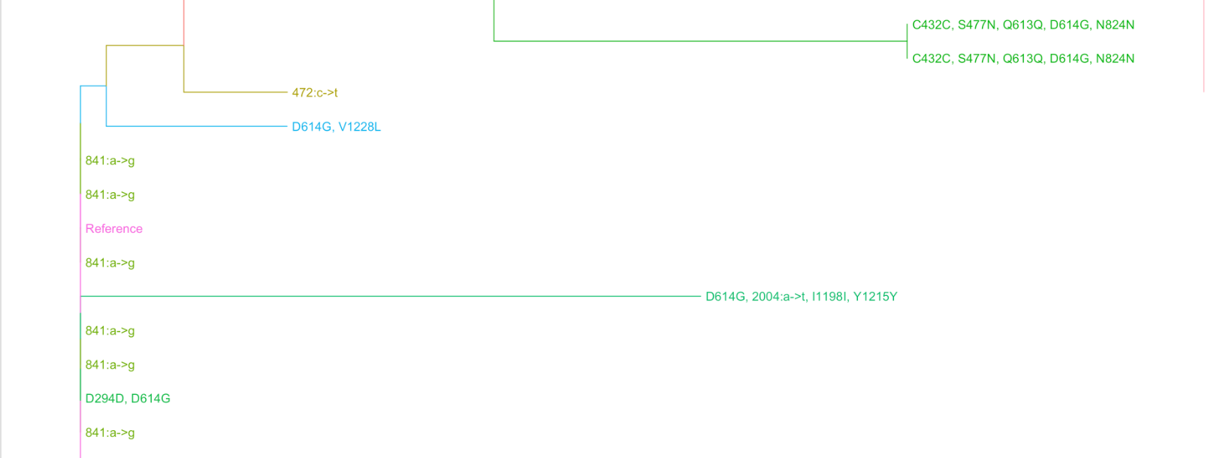
METHODS
Phylogenies
Figure 4. Snapshot of the country phylogeny, showing the Australian cluster.
Figure 5. Snapshot of the mutation phylogeny, showing the Australian cluster.
Notes:
Then we began to make the two phylogenies, which both contain 250 sequences and are therefore too big to show in this presentation, so snapshots of the most interesting parts are shown here. Figure 4 demonstrates the country phylogeny, which tracked the evolutionary relationship between the strains sorted by country. This allowed us to identify clades of interest (which are highlighted in Figure 4), focusing us on 8 groups of evolutionary COVID-19 clusters, which all occur in individual countries. In summary these clades show that COVID-19 evolved new mutations unique to these countries, creating variance between them and the rest of the world. The one of most interest is the Australia cluster, which is highlighted in pink on Figure 4. This cluster shows a few mutations that are not found in other parts of the world (A22V, C432C, S477N, N121N and more), and has shown the highest variance in unique mutations. Figure 4 shows the different mutations that have evolved within the Austraia cluster, most of which can only be found in that specific country. While there are other countries which show clusters of variation such as this, none has as many as Australia. Therefore, these phylogenies demonstrate that the region which is producing the greatest variety of strains within our data is Australia. Reasons for this may be due to its isolation as an island, and also its strict COVID-19 measures which isolated it even further from the rest of the world. Their mutations are unique to their own country, possibly because there were less travelers to spread it elsewhere, and because they restricted the borders therefore bringing in less foreign mutations.

Slide 8
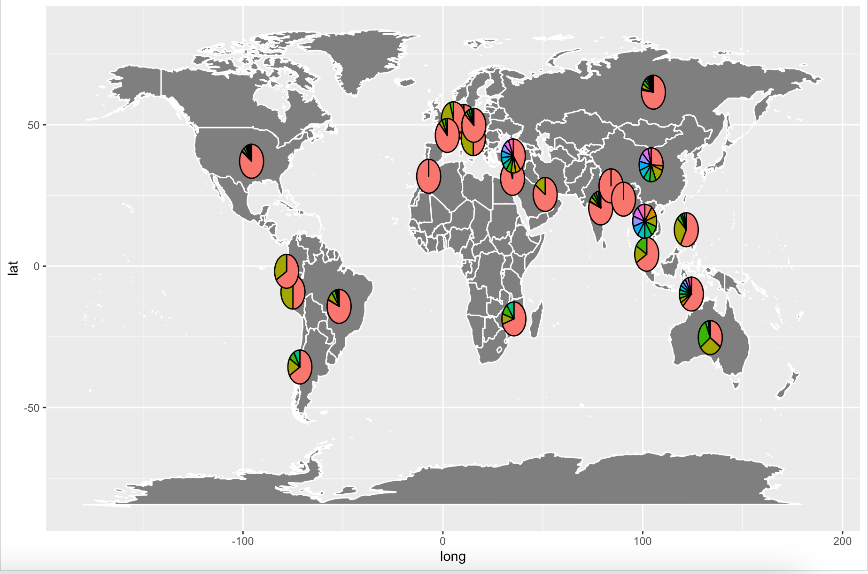
METHODS
Map of Mutations
Each pie chart represents the proportionality of the frequency in mutations.
The more variation in colours per country means the high number of mutations present.
The countries with the highest variation were China as well as Thailand.
The countries with the least variation were Morocco, Nepal and Bangladesh.
Figure 6. Geographical representation of the frequency of mutation s by country.
Notes:
Part of question one was which regions are producing the most variation in strains. We created a geographical map with the frequencies of the mutations for each country represented as pie charts. The pie charts represent the top ten mutations per country by how common the mutation was in that region. As mentioned above this could be due to which countries allowed foreign travellers to bring in other variants or just due to chance where spontaneous mutations may arise. The map represents the countries that submitted sequenced mutations which were uploaded to the NCBI database, not the eight that we exclusively assessed in previous sections. Throughout looking at the map we can see that the countries with the highest amount of SARS-Cov-2 spike protein variation were China as well as Thailand. The countries with the least variation were Morocco, Nepal and Bangladesh.

Slide 9
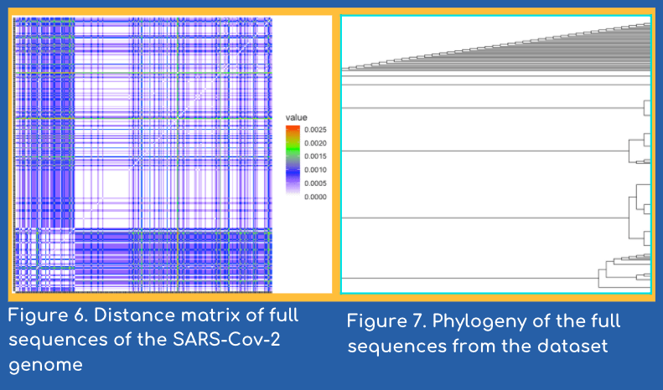
METHODS
Full Phylogeny
An alignment on full sequences was computed remotely
The bash script returned a fasta file alignment
A distance matrix and phylogeny was created from the full length sequences
Notes:
The analysis of full length Covid sequences was essential for contextualizing our findings. The spike protein is only 1/10th of the length of the total sequence. The distance matrix shows significantly less variation than the selected spike protein matrix.
The phylogeny has a distinct clade of sequences that have diverged from the majority. When analysed further the sequences were found to contain some prominent spike mutations.

Slide 10
CONCLUSIONS
BIOLOGICAL QUESTION #1
Australia shows the highest number of unique mutations
Map shows that the distribution of most mutations is global
BIOLOGICAL QUESTION #2
The most significant mutation in our research is D614G found all across the world
It causes an increase in COVID-19 severity and can be linked with increased spread
Notes:
In conclusion, our presentation was looking to answer two questions: How are mutations in the SARS-CoV-2 spike protein distributed geographically and temporally, and how are some clinically significant mutations distributed and what implications do these distributions have for future vaccine effectiveness, and potential risk of antigenic drift?
The two phylogenies, one showing evolutionary relationship between COVID-19 strands grouped by country, and the other by mutations, demonstrate that the country with the highest amount of unique mutations is Australia. While Australia has the highest amount of unique mutations, it by no means is the only country that shows results such as these, the world map with overlaid pie charts by their top ten mutations show the high diversity of mutations across the world. Mutations of the spike protein are often distributed globally, and it's interesting to see exactly where across the world different mutations seem to thrive.
Meanwhile the mutations accumulation graphs begins to answer our second biological question: How are some clinically significant mutations distributed and what implications do these distributions have for future vaccine effectiveness, and potential risk of antigenic drift? This graph and the subsequent table notes that the most common mutation in our research is the D614G mutation which causes a conversion of adenine (A) to guanine (G) at position 23,403 in the viral genome (1).This mutation has been correlated with a increase in the severity of COVID-19 symptoms, and is found across several different countries. This paired with the mutations world map shows that mutations are distributed widely, and that any sort of vaccine must be able to still function with the variety of different genome changes.

Slide 11

FUTURE RESEARCH
Important for informing public health officials on preventative measures like quarantines and lockdowns
Australia was linked with high mutation accumulation
Could be the result of tight COVID-19 regulations that isolated these mutations within the country
Chen et al. (2020) tracked the evolution of variants and lineages across different locations of interest in order to determine where and when the virus is mutating
Further research contributes to the growing COVID-19 database
Allows researchers to predict future rate of infections
Notes:
When it comes to stopping the spread of COVID-19, it is important for researchers to determine how the virus spreads and how the virus mutates. Studies like these allow scientists and healthcare professionals to predict how rapidly the virus will spread through a population, which ultimately aids in determining rates of infection. This information is what allows public health officials to make informed decisions on preventative measures, such as quarantines and lockdowns, to slow the spread. As Kaija mentioned, it was determined that Australia had a large mutation accumulation that was considered unique when contrasted with other countries. This could be attributed to Australia’s tight COVID-19 preventative measures that allowed them not only confine the development of mutations within their own country, but prevent foreign mutations from coming in. This speaks to the effectiveness of stricter COVID-19 regulations in isolating the spread of mutations to a given area.
An article by Chen et al. (2020) discusses the importance of tracking COVID-19 mutations in terms of evaluating the effectiveness of anti-COVID-19 measures and evolution of the virus itself. They designed an interactive webpage that tracks COVID-19 variants and lineages across various locations of interest. In particular, they found a mutation that has become dominant in Australia that was orignally discovered in January of 2020. The sustained and now dominant transmission of this variant suggests local transmission has been sustained and isolated within Australia.
It is crucial that research like this continues to be conducted such that the COVID-19 genome database can be consistently updated with new variants and lineages that may allow researchers to predict future spread and rate of infection. While the many mutations found in Australia are mostly non-synonymous, tracking the development of other mutations, including the highly infectious UK variant could allow for new disease spread projections.

Slide 12
REFERENCES
Biswas, S., & Mudi, S. (2020). Spike protein D614G and RdRp P323L: the SARS-CoV-2 mutations associated with severity of COVID-19. Genomics & Informatics, 18(4), e44–e44. https://doi.org/10.5808/GI.2020.18.4.e44
Chen, A. T., Altschuler, K., Zhan, S. H., Chan, Y. A., & Deverman, B. E. (2020). COVID-19 CG: Tracking SARS-CoV-2 mutations by locations and dates of interest. Biorxiv.

